Slide 1
Data Science Capstone
Linear Regression Model for
Housing Price Prediction
By:
Rajan Gyawali

Slide 2
Presentation outline
Introduction/Business Problem
Data Collection/Preprocessing
Methodology
Results
Discussion
Conclusion

Slide 3
Introduction/Business Problem
Linear Regression Model for prediction of Housing Price
Linear Regression Model is used for predicting the continuous target value that is dependent upon number of independent variables.
Business Problem:
How much more price one can sell his/her house with additional bedroom/bathroom?
How does the price of house differ with increase in square feet?
What is the impact of number of years built for the pricing of houses?

Slide 4
Data COLLECTION/ PREPROCESSING
The dataset consists of attributes like:
Price
Number of Bedrooms
Number of Bathrooms
Living Room Area
Number of Floors
Waterfront
View
Condition of the House
Year built
Year renovated, etc

Slide 5
Methodology
A basic linear regression model can be formulated as:
y = a₀ + a₁x₁ + a₂x₂ + a₃x₃ + a₄x₄ + …
The attributes used for linear regression model are:
price
Bedrooms
Bathrooms
sqft_living
sqft_lot
floors
waterfront
view
condition
grade
sqft_above
sqft_basement
number_of_days_built

Slide 6
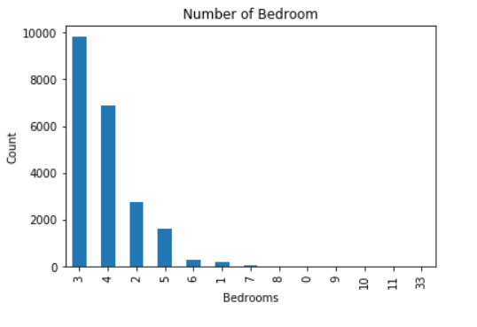
Methodology
Figure: Plot of Number of Bedrooms Vs Count of Houses

Slide 7
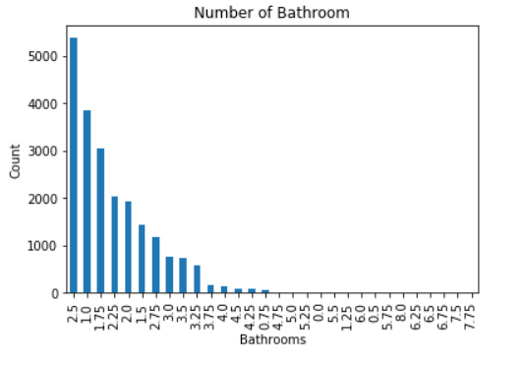
Methodology
Figure: Plot of Number of Bathrooms Vs Count of Houses

Slide 8
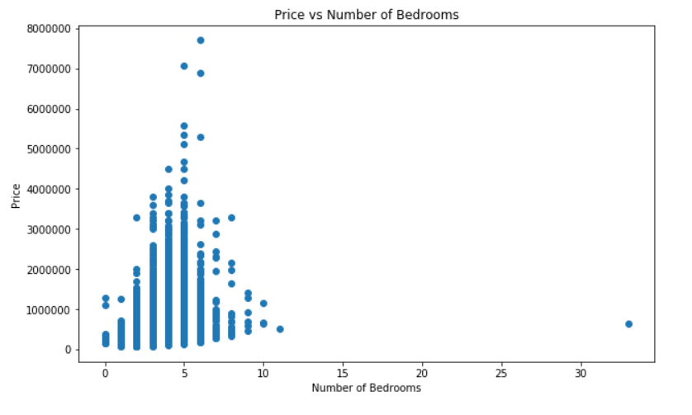
Methodology
Figure: Scatter Plot to show relationship between price and number of bedrooms

Slide 9
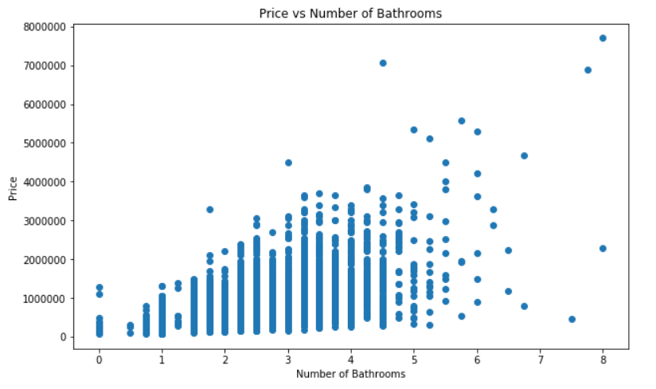
Methodology
Figure: Scatter Plot to show relationship between price and number of bathrooms

Slide 10
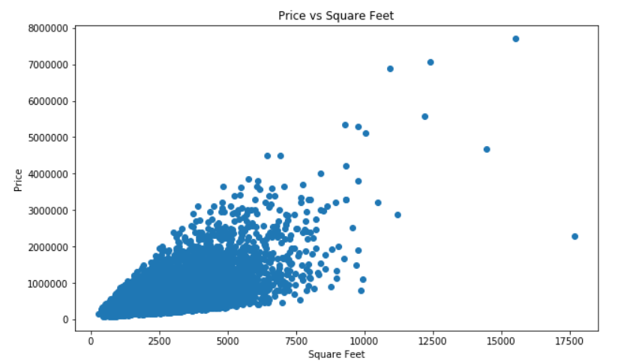
Methodology
Figure: Scatter Plot to show relationship between price and squarefeet

Slide 11
Methodology
From the overall dataset, 80% is converted to training set and rest 20% is converted to test set.
With these training samples, the machine learning model for linear regression is modeled and fitted with the scikit learn library.
The fitted model is tested with the test dataset and a regression score is calculated.

Slide 12
RESULTS
Predicted Price | Actual Price
666735 | 735000
1455081 | 1150000
337335 | 350500
1183792 | 860000
191910 | 122000
750749 | 725000
644535 | 417000
551787 | 594950
511011 | 471000
820174 | 634950
518060 | 500000
770764 | 768000
486381 | 323000
418779 | 430000
609564 | 625000
609511 | 710000
455584 | 620000
1015401 | 665000
1609385 | 1600000
1109880 | 875000

Slide 13
Discussion & CONCLUSION
Housing price prediction is done with Linear Regression Model
Linear Regression Model Can be used for predicting continuous target value.
With increase in number of training samples, accuracy of the model can be increased.

Slide 14
Data Science Capstone
Thank You !!!

